Slide 1

Requirement Analysis for Quality of Experience Mobile Application
Following the requirement gathering (done in task 2), the information gathered needs to be analysed for further processing and to detect error, uncompleted, missing or ambiguous data in the data collection process to save time and cost in the development of the project.
Requirement analysis is the process of refining and structuring the gathered requirements to ensure they are clear, feasible, and aligned with stakeholder goals.

Slide 2
Review and Analysis of Gathered Requirements
Completeness
Clarity
Technical Feasibility
Dependency Relationships
The data captured both subjective (user feedback) and objective (network metrics) requirements.
Most user responses were clear, though some feedback required rephrasing for technical understanding.
The app's main features (background monitoring, prompting for feedback, logging network metrics) are feasible using Android's APIs and third-party libraries.
Continuous background activity depends on battery optimization settings. Real-time location tracking depends on GPS permissions. Feedback prompts rely on user interaction at scheduled intervals.
The review confirmed that the gathered requirements are largely relevant, feasible and aligned with user needs. Some dependencies and technical considerations were noted, laying the groundwork for the next phase of design and development.

Slide 3
Identified Inconsistencies, Ambiguities, and Missing Information
Inconsistencies and Ambiguities
Missing Information
Target Platform Not Specified: Unclear if app is for Android, iOS, or both.
Target Users: Who will use the app? General public, volunteers, etc.
User Feedback Frequency: Vague how often will users be prompted?
Authentication: Is login required or is the app anonymous?
Feedback Mechanism: What format is the feedback in (rating, text, etc.)?
Data Collection Permissions: No clarity on consent for accessing sensitive data like location.
Analysis Tools: Will there be dashboards or reports for network operators?
Scope of Network Metrics: Collection methods for jitter, latency, and packet loss are not detailed.
Operator Identification: How is the user's network operator detected or recorded?
Data Security & Privacy: No mention of how data is protected or anonymized.
Data Collection Frequency: How often is passive data collected?
Internet Usage: Will the app use mobile data for transmission, and is this disclosed to users?

Slide 4








Prioritized Requirements
Must Have
Essential core functionality
Should Have
Important but not critical
Could Have
Enhances the app but lower priority
Won't Have
Low importance or not feasible
Our Quality of Experience (QoE) app transforms how users and providers like MTN, Orange and CAMTEL tackle network issues by gathering feedback and tracking metrics like signal strength, call quality, and internet speed. By zeroing in on features that matter most to users—like signal strength, critical for 47.2%—and ensuring they're achievable with our Android tools in the time allocated for the work, we've crafted a focused plan. Guided by the survey responses, this prioritization delivers a user-friendly app that maximizes network performance for all.

Slide 5




Detailed Prioritization Breakdown
Must Have Requirements
Track Signal Strength: Monitor signal strength metrics, critical due to 47.2% of users reporting poor signal (Task 2, page 5).
Track Slow Internet: Measure bandwidth and latency, vital as 43.4% face slow internet issues.
Track Call Breakages: Capture jitter and latency for audio/video calls, with 58.5% reporting breakages.
Star Ratings for Feedback: Allow users to rate satisfaction, speed, and usability, expected by users (survey question) and simple to implement via Android UI.
Should Have Requirements
Location Tracking with Consent: Log feedback with location data, supported by high survey responses (page 6) noting location's influence, but requires user permission handling.
Data Deletion Option: Enable users to delete their feedback, addressing privacy concerns (high demand, page 7) and feasible with database controls.
Simple User Interface: Design a straightforward UI, requested by users ("simple, straightforward," page 7), achievable with Android layouts.
Low Battery and RAM Usage: Optimize resource consumption, a user concern ("not battery draining," page 7), possible with profiling but secondary.
Could Have Requirements
Weekly Feedback Prompts: Remind users to provide feedback weekly, preferred by 60% of respondents (page 7),
implemented with simple timers.
Free Data Donations: Not feasible and outside project scope.
Won't Have Requirements
Scam Detection: Suggested by users but unrelated to QoE and technically complex (requires AI, 9-12 months).
iOS Support: Not viable as the project focuses on native Android (Task 1).
Real-Time Notifications: High effort (complex networking) and less critical than core metrics.
Global Access: Unaffected by climate/topography, not feasible within timeline and skills.

Slide 6
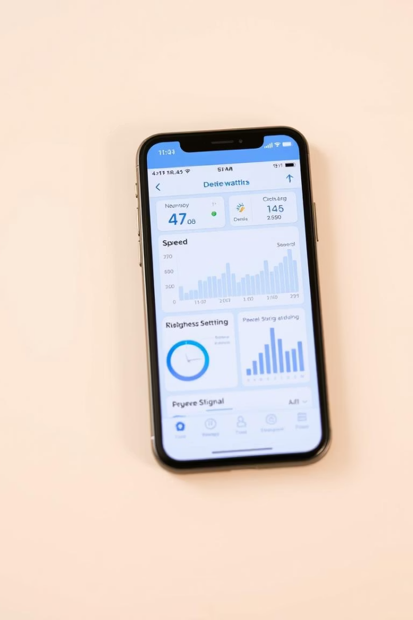
Requirements
The requirements for our network performance monitoring mobile application are categorized into functional, non-functional, and user experience aspects to ensure the app meets user expectations, improves network performance, and encourages widespread adoption.

Slide 7




Functional Requirements
Functional requirements define what the system must do. These are based on the needs of stakeholders and the feedback collected from users. Additional functional requirements include scam detection, ISP integration, data usage tracking, cross-platform availability, offline mode, and customizable user settings that provide options to enable or disable features like notifications, background data collection, and location tracking.
User Registration and Authentication
Users should be able to register and log in securely
Include a feature to reset forgotten passwords
Network Performance Monitoring
Collect and display network metrics such as latency, packet loss, and bandwidth
Allow users to view their network performance history
Feedback Collection
Provide a feature for users to submit feedback on network issues
Enable users to rate their network service providers
Enable users to to choose the rate at which feedback are been asked
Real-Time Notifications
Notify users of network issues in their area
Send alerts for improvements or updates on network performance

Slide 8





Non-Functional Requirements
Security
Implement secure data storage and transmission with encryption
Performance
Minimal battery consumption and optimal handling of large data
Scalability
Handle increasing users and data without performance degradation
Compatibility
Support different devices, operating systems, and screen sizes
Reliability
Remain stable during heavy network use
Non-functional requirements focus on the system's performance, usability, and other quality aspects.

Slide 9
User Experience (UX) Requirements
User Interface (UI)
Ease of Use
Provide a clean, simple, and intuitive design
Simplify complex terms (e.g., latency) for non-technical users
Use minimalistic layouts with clear navigation
Include tutorials to guide users
Accessibility
Customizable Notifications
Ensure the app is lightweight and does not occupy much device storage or RAM
Allow users to customize notification preferences (frequency, type, etc.)
Design for accessibility, including support for visually impaired users
Feedback-Friendly Design
Battery Efficiency
Simplify the process of submitting feedback
Optimize the app to minimize battery usage during background operations
Use interactive elements, such as sliders and buttons, for user ratings
User experience requirements focus on ensuring the app is intuitive, accessible, and enjoyable to use. Additional UX requirements include real-time updates (ensuring real-time performance tracking and issue notifications, providing live updates on network metrics), multi-language support (including options for multiple languages to cater to diverse users).

Slide 10



Software Requirements Specification
Purpose and Scope
System Features
A mobile application for collecting real-time data from mobile subscribers for better network performance insights. Its scope revolves around collecting device/network parameters and user feedback, uploaded to a centralized backend.
Passive Monitoring Module: Collect signal strength periodically, log network type (3G/4G/5G), measure latency and jitter via ping. Active Feedback Module: Prompt users for feedback every 24 hours if no network issue and every 12 hours if network issues, allow 1-5-star ratings, log feedback with timestamp and location.
Data Management
Interfaces and Requirements
Store logs locally before upload, upload logs every 60 minutes, encrypt data before transmission. Request permission for sensitive data, let users opt out of metrics, anonymize user data.
User Interfaces: Simple UI, feedback screen, and settings. Software Interfaces: Android APIs & IOS API. Communication Interfaces: REST API over HTTPS, JSON data format. Non-Functional Requirements: CPU usage under 5% when idle, encrypted data transmission, feedback submission under 30 seconds, auto-restart on crash, optimized background performance.

Slide 11
Validation of Requirements with Stakeholders
Collect Feedback and Update SRS
Present and Discuss Requirements
Schedule Validation Sessions
Create a feedback log or validation matrix to record stakeholder input. Based on validated feedback, modify unclear or incorrect requirements, add new requirements as requested, remove irrelevant or redundant ones, and highlight all changes using version control or change tracking. Finally, share the updated SRS with stakeholders for formal approval.
Identify Stakeholders
Use the SRS document to walk stakeholders through functional requirements (what the system should do), non-functional requirements (performance, security, usability, etc.), and constraints and assumptions. Technique used: Requirement walkthrough where we explained each requirement and stakeholders could raise issues or ask questions.
List all key stakeholders involved in or affected by the system. These may include Mobile Network Operators (MNO), end users (e.g., mobile app users), software development team (developers, UI/UX designers), and technical stakeholders like app developers and network engineers.
Set up requirement review meetings or validation workshops with all stakeholders. Tools used: In-person meetings. Material shared: Software Requirements Specification (SRS), Use case diagrams, and User stories. Present each requirement, collect stakeholder feedback, validate the feasibility and relevance.

Slide 12

Conclusion
5
3
78.5%
Team Members
Key Phases
Call Breakages etc
Analysis, Prioritization, Specification
Top user issue identified
Through this task, we successfully transformed user feedback and survey insights into structured, validated, and actionable requirements. This sets the stage for effective system modelling and design. The requirement analysis process helped identify inconsistencies and ambiguities, prioritize features based on user needs and technical feasibility, classify requirements into functional and non-functional categories, develop a comprehensive software requirements specification, and validate the requirements with stakeholders to ensure alignment between developers and users.

